Slide 1
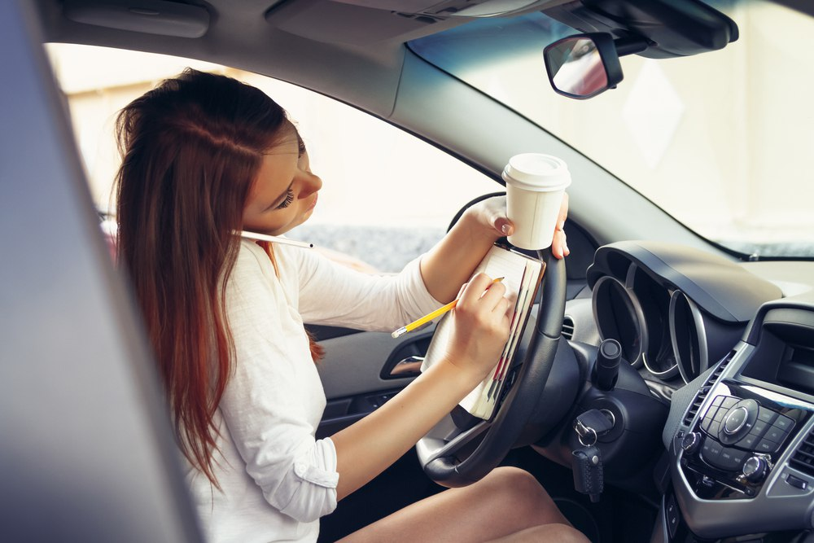
Detection of inattentive drivers Papers presentation
Giuseppe Cancello Tortora
Mirko Casini
Andrea Lagna
Martina Marino

Slide 2


Papers
Driver Distraction Detection Methods: A Literature Review and Framework
Alexey kashevnik, Roman Shchedrin, Christian Kaise, Alexander stocker
Review of the published scientific literature
Driver Distraction Recognition Based on Smartphone Sensor Data
Jie Xie, Allaa R.Hilal, Dana Kulic
A direct research experience

Slide 3
Driver Distraction Detection Methods: A Literature Review and Framework
Introduction and motivation
25% of police-reported crashes involve some form of driver inattention such as the driver is distracted, fatigued or lost in thought
Vehicle manufacturers, suppliers, start-ups and researchers are devoting more and more resources to better understand and measure the causes of driver distraction and inattention
Developing of warning and prevention mechanisms for drivers and increasing the automation level of vehicles

Slide 4
Driver Distraction Detection Methods: A Literature Review and Framework
Background
Driver distraction
the diversion of attention away from activities for safe driving toward a competing activity
Types of distraction
Visual distraction
Manual distraction
Cognitive distraction
Auditory distraction
Vocal distraction
Verbal distraction
6 levels of driving automation
No automation
Driver assistance
Partial automation
Conditional automation
High automation
Full automation

Slide 5
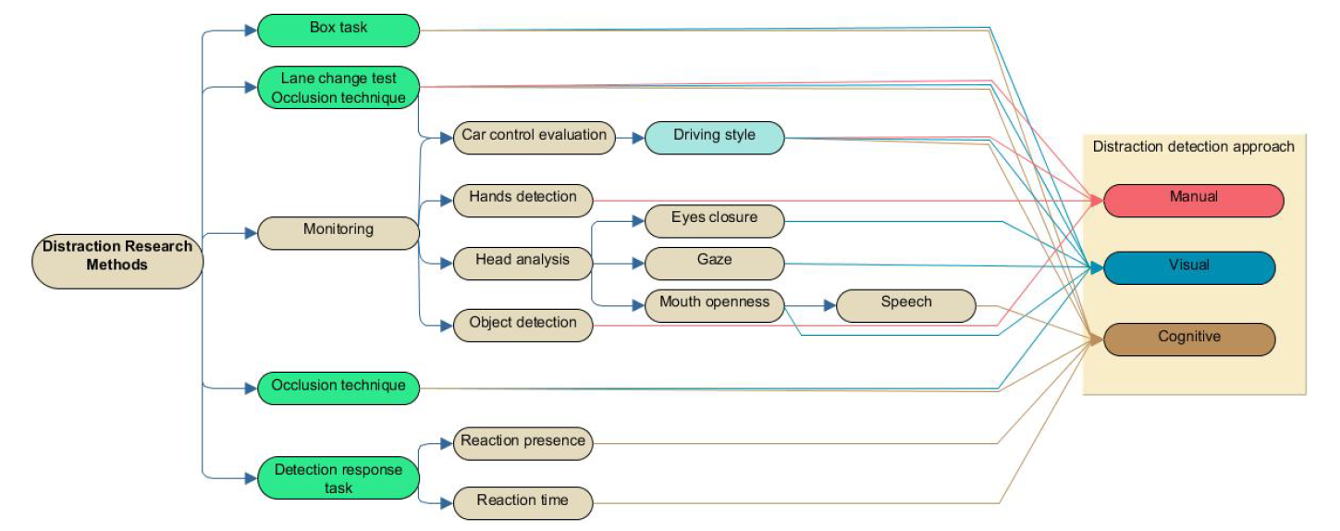
Driver distraction evaluation methods
Driver Distraction Detection Methods: A Literature Review and Framework
Laboratory environment only
Both laboratory and real driving conditions on public roads

Slide 6
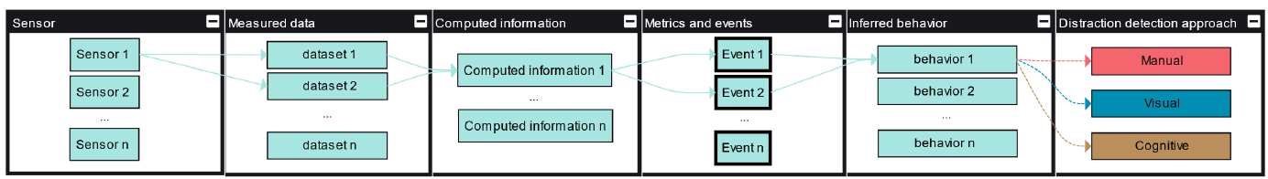
Distraction detection process
Driver Distraction Detection Methods: A Literature Review and Framework
Sensors
Measured data
Computed information
Metrics and events
Inferred behavior
Distraction type

Slide 7
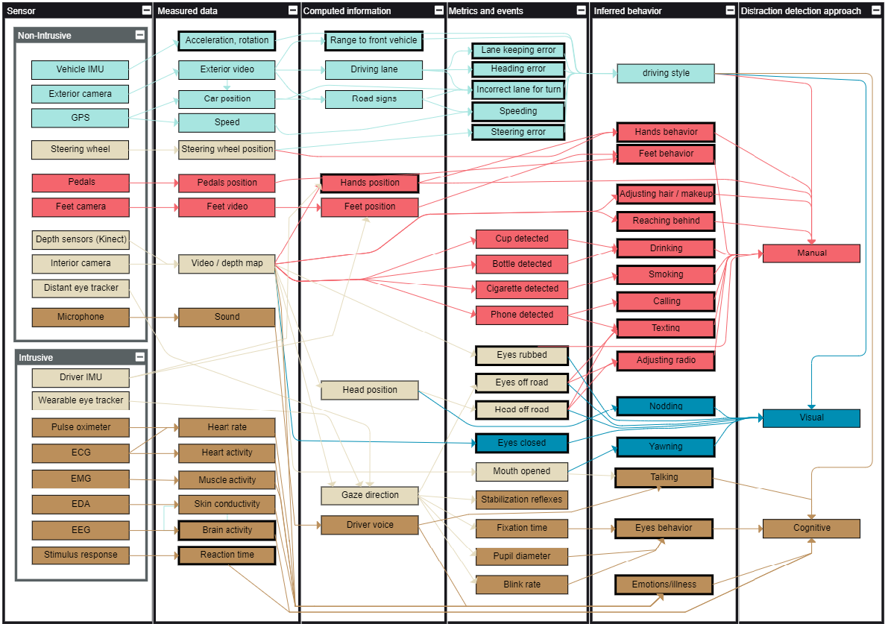
Driver Distraction Detection Methods: A Literature Review and Framework
Notes:
Light brown → multiple final nodes
Light blue → driving style
Red → manual distraction
Blue → visual distraction
Brown → cognitive distraction

Slide 8
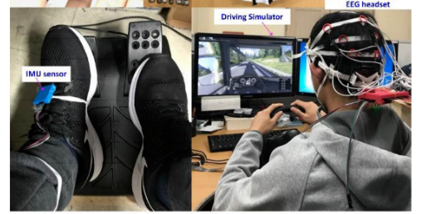
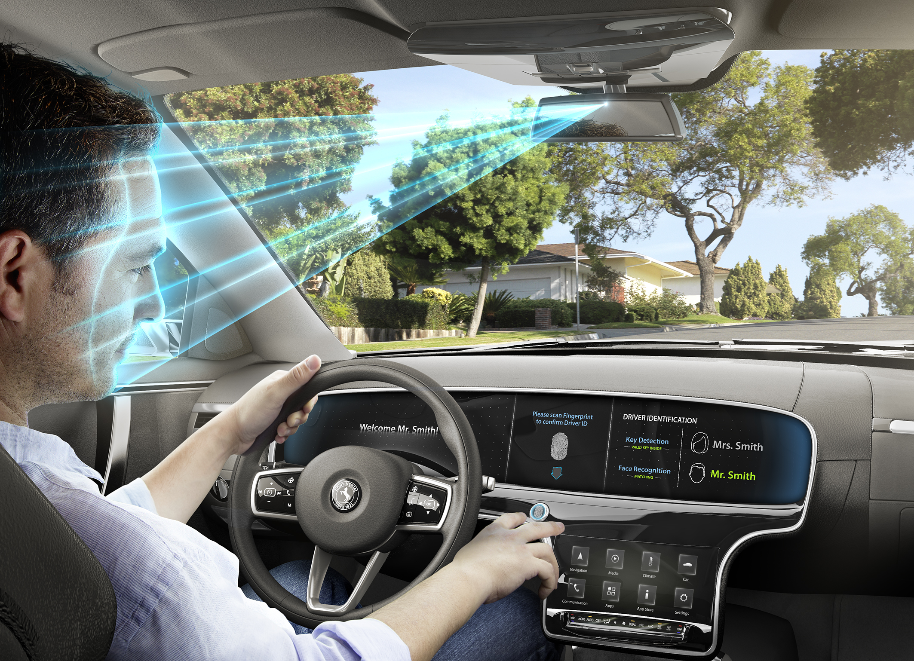
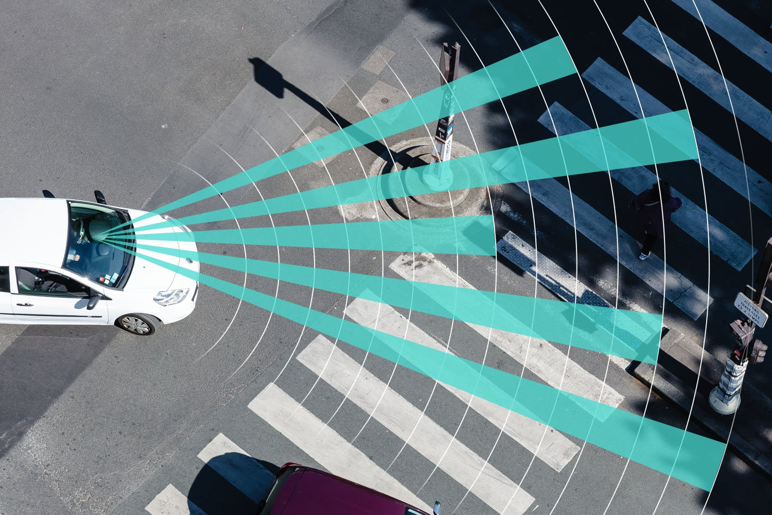
Intrusive VS non-intrusive sensors
Driver Distraction Detection Methods: A Literature Review and Framework
Intrusive sensors
Can obtain more accurate data regarding certain causes of distraction
More useful for research purposes and to collect ground truth
Non-intrusive sensors
Do not distract the driver
Are more adequate for commercial systems
Do not interfere with the movements and poses of the driver

Slide 9
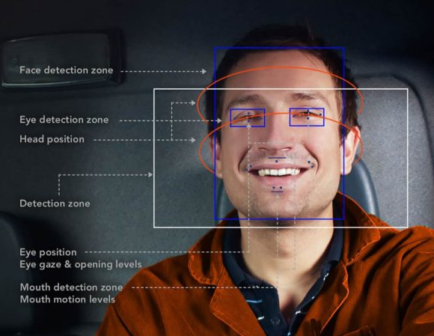

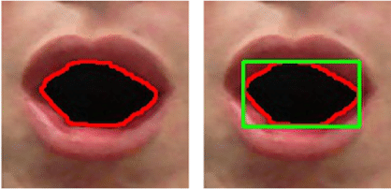
How to detect distraction (non-intrusive sensors)
Driver Distraction Detection Methods: A Literature Review and Framework
1/4
SVM-based algorithms to detect eye closure.
Perspective-N-Points solution combined with RANSAC to analyze head pose.
ML regression algorithms directly on captured image data

Slide 10
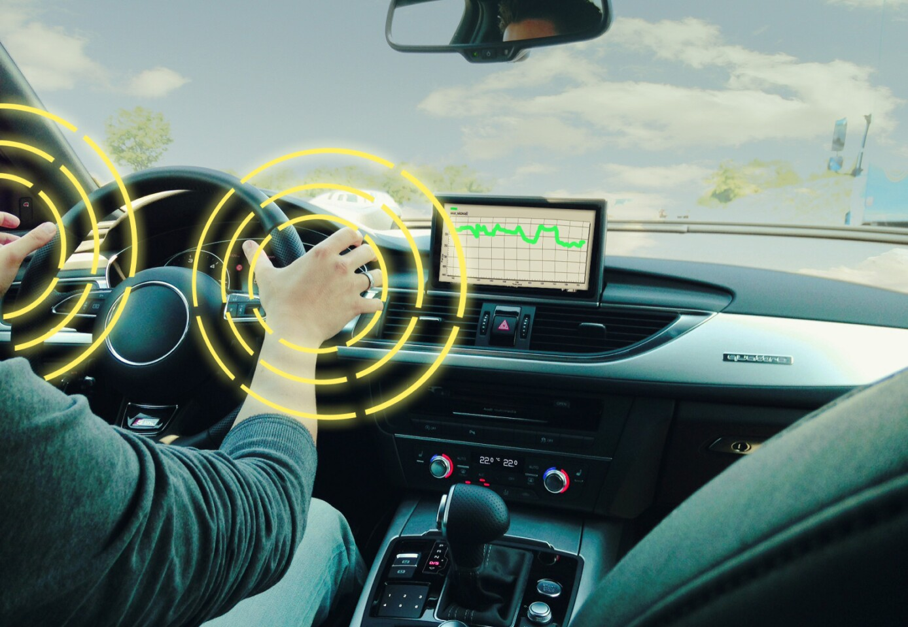
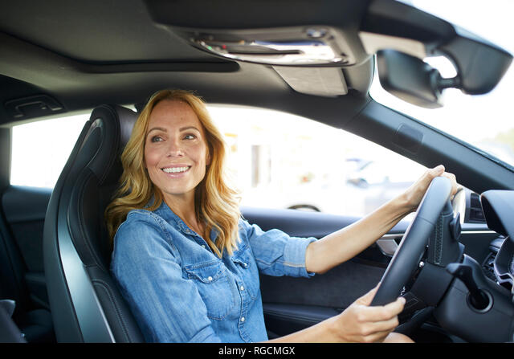
How to detect distraction (non-intrusive sensors)
Driver Distraction Detection Methods: A Literature Review and Framework
2/4
Neural networks or computer vision algorithms used to estimate gaze direction
In case the driver’s hands are not fully captured by the camera AdaBoost classifier should be used

Slide 11

How to detect distraction (non-intrusive sensors)
Driver Distraction Detection Methods: A Literature Review and Framework
3/4
Features extracted from optical flow can be passed to a Hidden Markov Model (HMM) and argue that this might help to predict pedal misapplications

Slide 12



Driver Distraction Detection Methods: A Literature Review and Framework
How to detect distraction (non-intrusive sensors)
4/4
Training a ML algorithm on MelFrequency Cepstral Coefficients features (but other features and approaches can also be used)

Slide 13
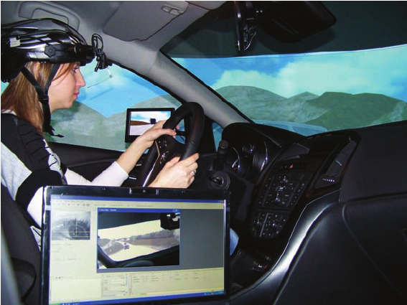
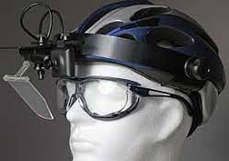
How to detect distraction (intrusive sensors)
Driver Distraction Detection Methods: A Literature Review and Framework
It is also possible to evaluate a lot of aspects from analyzing the eye behaviour while driving in different conditions.

Slide 14

Conclusions
Driver Distraction Detection Methods: A Literature Review and Framework
Drivers will still have to be attentive
Vehicle manufacturers will expand sensors technologies for a better interpretation of vehicle external and internal environment
Distraction detection systems will be more and more important both if the autonoumous level increase or decrease

Slide 15
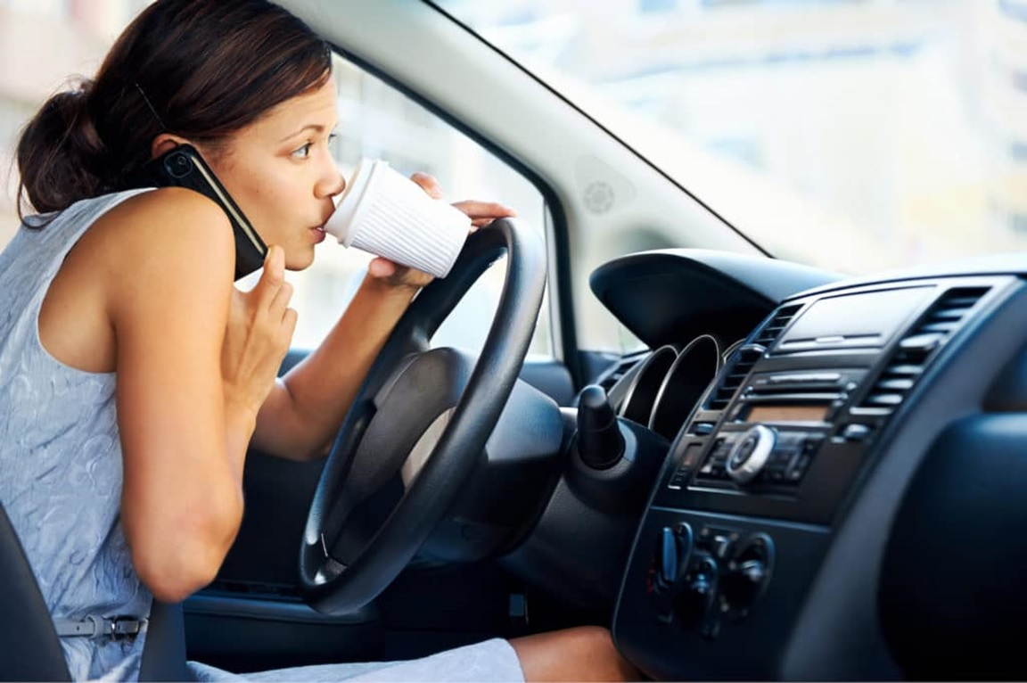
Papers
Driver Distraction Detection Methods: A Literature Review and Framework
Alexey kashevnik, Roman Shchedrin, Christian Kaise, Alexander stocker
Review of the published scientific literature
Driver Distraction Recognition Based on Smartphone Sensor Data
Jie Xie, Allaa R.Hilal, Dana Kulic
A direct research experience

Slide 16
Introduction
Driver Distraction Recognition Based on Smartphone Sensor Data
Driver distraction is one of the leading causes of vehicle accidents and injury
24 drivers between 21 and 52 yo were recruited to participate, driving on a route consisting of suburban and highway driving.
The study develops a smartphone sensor based driver distraction system using an ensemble learning method.
Study
Experiment

Slide 17




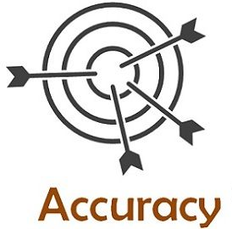

Previous studies
Driver Distraction Recognition Based on Smartphone Sensor Data
Detection of driver cognitive distraction at stop-controlled intersection by using a driving simulator for collecting data
3 types of features: scenario-based, sensor-based and eye-movement features.
LIMITS OF THESE STUDIES:
Only video data for driver distraction recognition
Limitated usability while driving at night
Privacy issue

Slide 18




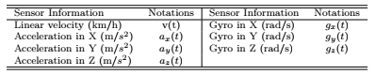
Objective of this work
Driver Distraction Recognition Based on Smartphone Sensor Data
Estimate driver distraction from the driver’s mobile device, using only motion data collected by the IMU and GPS sensors.
DATA COLLECTION
INTERPOLATION AND NOISE REDUCTION
SIGNAL FEATURES
SLIDING WINDOW FOR FEATURE EXTRACTION
Mean, variance, median, range, kurtosis, skewness, root-mean-square

Slide 19

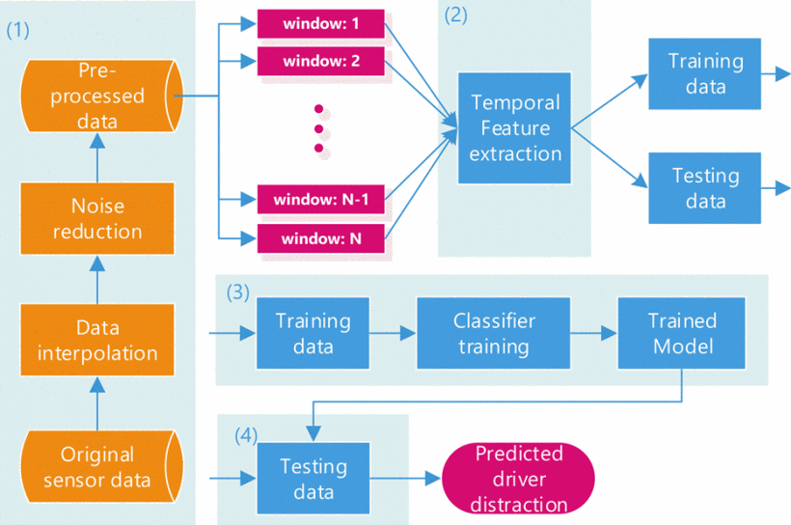
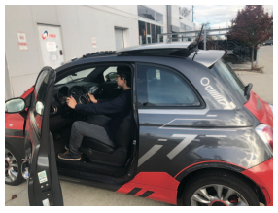
Pipeline
Driver Distraction Recognition Based on Smartphone Sensor Data
Driver distraction recognition system consists of 4 steps:
IMU sampling rate: 100 Hz
Linear velocity (from GPS) sampling rate: 1 Hz
3 road conditions:
Parking lot
Highway
City road

Slide 20
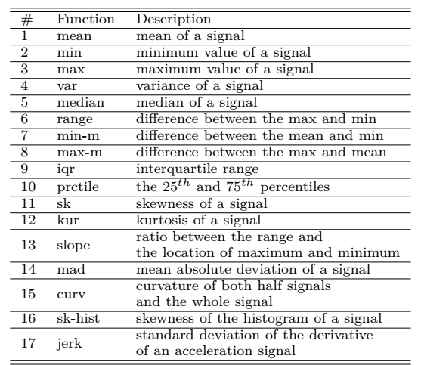
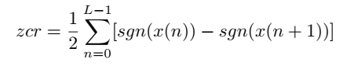
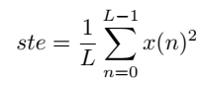
Feature extraction
Driver Distraction Recognition Based on Smartphone Sensor Data
Before feature extraction, noise reduction is applied:
moving median (outlier removal from signal) filter
moving mean (smoothing filtered signal) filter
For each sliding window, 19 temporal features were considered:
18) zero-crossing rate:
19) short-time energy:

Slide 21
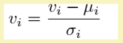
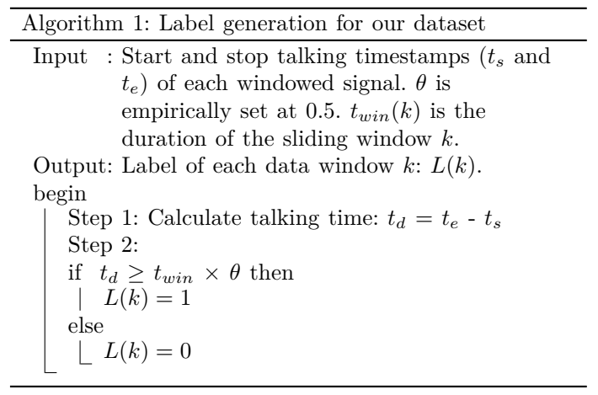
Label generations for dataset
Driver Distraction Recognition Based on Smartphone Sensor Data
After feature extraction, all features are concatenated together to form a feature vector of dimension 273.
Then, the normalization is conducted as follows:

Slide 22

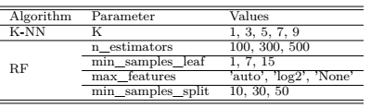
Classification
Driver Distraction Recognition Based on Smartphone Sensor Data
4 standard classifiers:
K-NN
Logistic Regression
Ensemble learning:
Returns labels as argmax of the sum of predicted probabilities
Naive-Bayes
Random Forest
GridSearch is used to optimize the parameters using 5-fold-cross-validation.

Slide 23
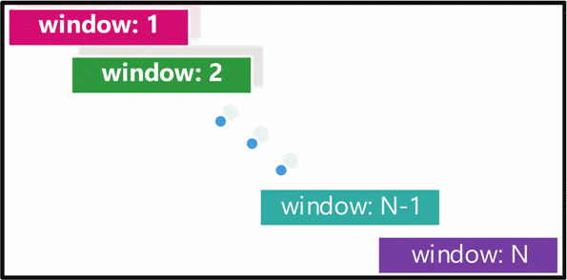

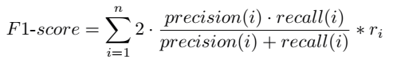
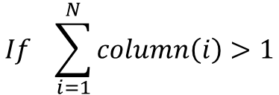
Evaluation
Driver Distraction Recognition Based on Smartphone Sensor Data
For each classifier output, a label is assigned to each sliding window that is re-converted back to sample labels for the evaluation.
$$If \sum_{i=1}^{N}{column\left(i\right)>1}$$
DISTRACTED DRIVING
The proposed system is evaluated using a weighted F1-score, defined as follows:
Notes:
Each column of the matrix is one sample
Ri -> ratio between the number of samples of one class and the total number of samples in all classes

Slide 24
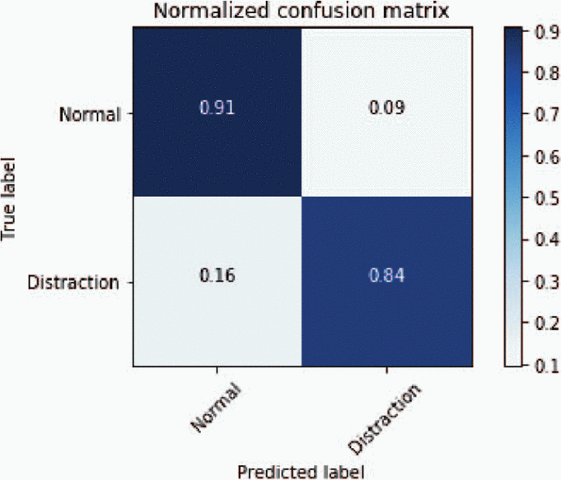
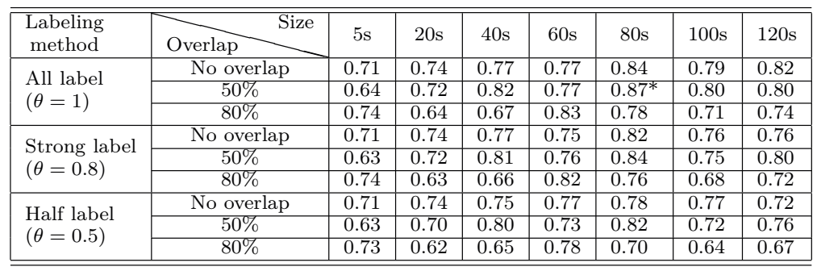
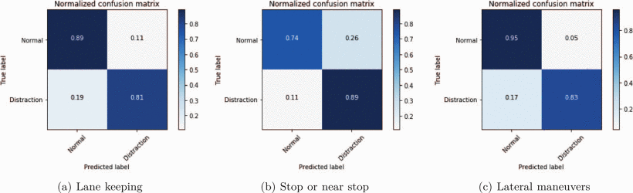
Results (1/2)
Driver Distraction Recognition Based on Smartphone Sensor Data
F1-score:
74.3%
83.8%
87.3%

Slide 25
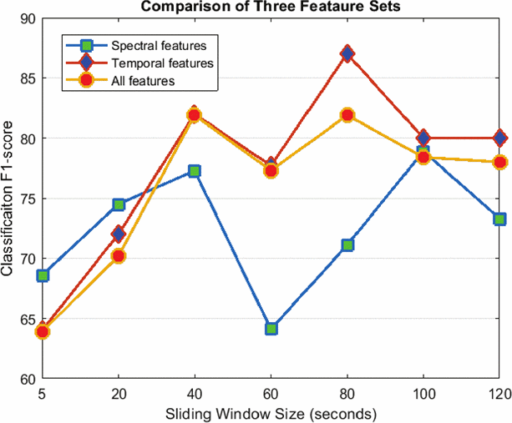
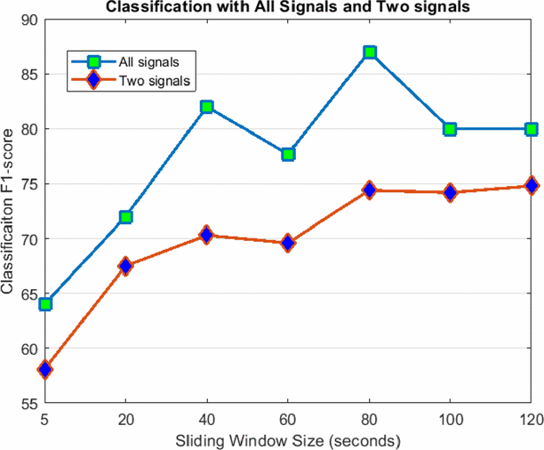
Results (2/2)
Driver Distraction Recognition Based on Smartphone Sensor Data
v(t) and g_{z}(t) -> most important signals
min, mean-min and median -> most important features
Notes:
Spectral features -> frequency domain but not improve, also considering all the features together
Random forest to select the 2 most important signals: linear velocity and z-axis gyroscope with min, mean-min and median the most important features
Min and mean-min of gz(t)-> capture vehicle shifting,
Min mean-min and median of v(t) may detect erratic braking
Worse classification with only 2 signals

Slide 26
Conclusions
Driver Distraction Recognition Based on Smartphone Sensor Data
Driver cognitive distraction recognition systems relying only on the mobile phone was developed, which do not require viewing the driver or knowing the driver or the outside conditions.
Do not need to perform maneuver detection, but performance is improved when the driver is performing more difficult maneuver.
Only one cognitive distraction is tested by talking to the passenger while driving.

Slide 27
THANK YOU FOR
THE ATTENTION

